Slide 1

A Project on Car Damage Detection using Computer Vision
Under Guidance of Prof. Priti B. Warungse
Atharva Kasar B191054257
Apurva Kshirsagar B191054268
Geeta Hade B191054242
Nishant Khandhar B191054261
NBN Sinhgad Technical Institute
2023-2024 Sem VII

Slide 2
Index
Introduction
Motivation
Objectives
System Architecture
Methodology
Technologies
Literature Survey
Applications
Advantages
Conclusion
References
NBN Sinhgad Technical Institute
2023-2024 Sem VII
Group 30

Slide 3
INTRODUCTION
A vehicle-damage detection technique based on transfer learning and a Regional Convolutional Neural Network (RCNN) are utilized to quickly handle accident compensation problems. The algorithms identify the damaged section of a car, determine its position, and then estimate the severity of the damage. Very satisfactory results have been produced using transfer learning to take advantage of available models that have been trained on a more generic object identification challenge.
NBN Sinhgad Technical Institute
2023-2024 Sem VII
Group 30

Slide 4
Motivation
The problem of vehicle damage plagues the automotive industry. Vehicles are prone to damage in several ways, including accidents, collisions, natural disasters, and wear and tear.
This problem affects several industries, including car manufacturers, insurers, car rental companies, and individual vehicle owners.
The problem is significant, as inaccurate or delayed damage assessments can lead to increased costs for insurers, longer processing times for claims, and customer dissatisfaction.
Inaccurate assessments can also lead to fraud, which costs the industry billions of dollars annually.
In addition to the cost of repairs, vehicle damage can result in other losses, such as lost productivity due to downtime, increased insurance premiums, and reduced resale value.
NBN Sinhgad Technical Institute
2023-2024 Sem VII
Group 30

Slide 5
Objectives
Computer vision technology can play a significant role in solving the problem of vehicle damage.
Using machine learning algorithms, computer vision systems can quickly and accurately identify vehicle damage, including dents, scratches, and other types of damage.
To minimize the time required for claim processing and maximize speed and accuracy.
To classify the damage on the basis of severity.
The reduce the number of fraud claims.
To decompose the problem of estimating the cost of car damage in a way that allows it to be applied to real-world datasets.
NBN Sinhgad Technical Institute
2023-2024 Sem VII
Group 30

Slide 6
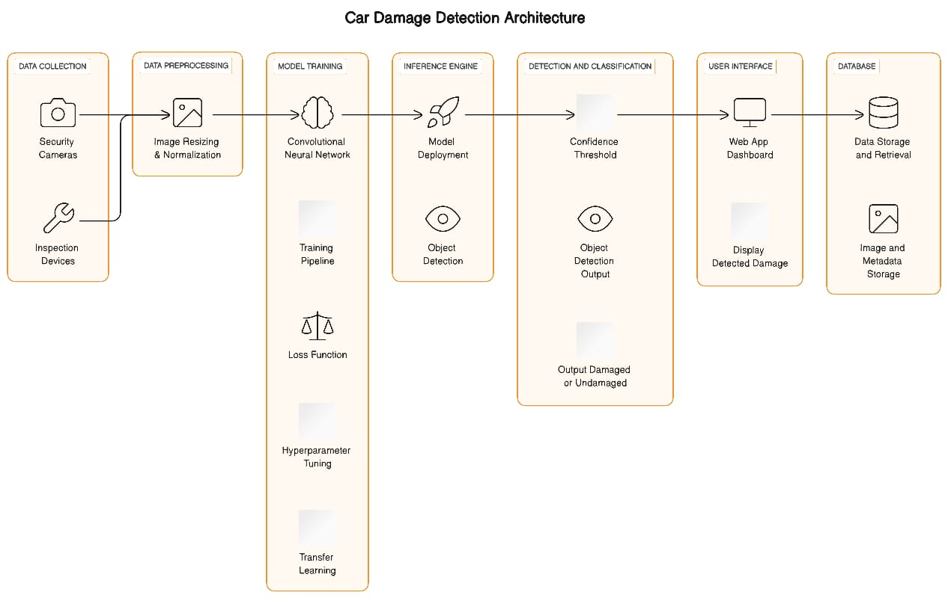
System Architecture
Diagram 1: System Architecture

Slide 7
Methodology
We begin by importing the required libraries.
Next, we preprocess our data, which includes resizing our images, one-hot encoding our labels, etc.
Model Selection: selection of computer vision model (e.g., Convolutional Neural Network, CNN) suitable for image classification or object detection tasks.
Model Training: Train the selected model using the training dataset. Fine-tune the model if needed.
Validation: Evaluation of the model's performance on the validation dataset. Adjusting hyperparameters as necessary.
Testing: Assessing the model's accuracy, precision, recall, and F1 score on the test dataset to ensure it generalizes well
User Interface: Creating a user-friendly interface for users to input images and receive damage detection results
NBN Sinhgad Technical Institute
2023-2024 Sem VII

Slide 8
Algorithms Used:
Convolutional Neural Network (CNN)
Region based Convolutional Neural Network (R-CNN)
Layers Used:
Input Layer
Convolutional Layer
Pooling Layers
Fully Connected Layers
Output Layer
NBN Sinhgad Technical Institute
2023-2024 Sem VII

Slide 9
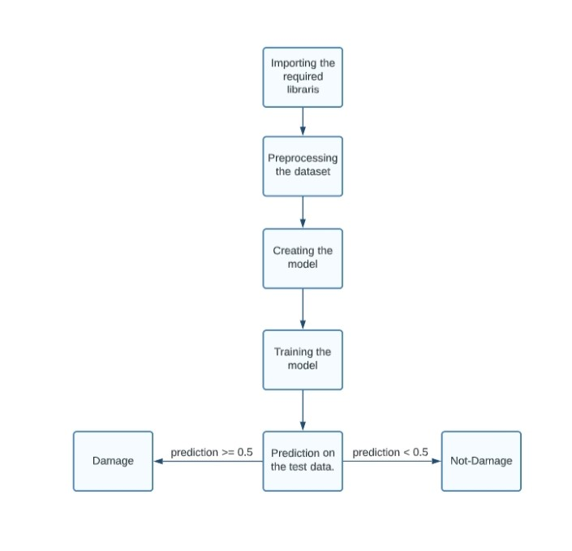
Figure 2: Flow Diagram

Slide 10
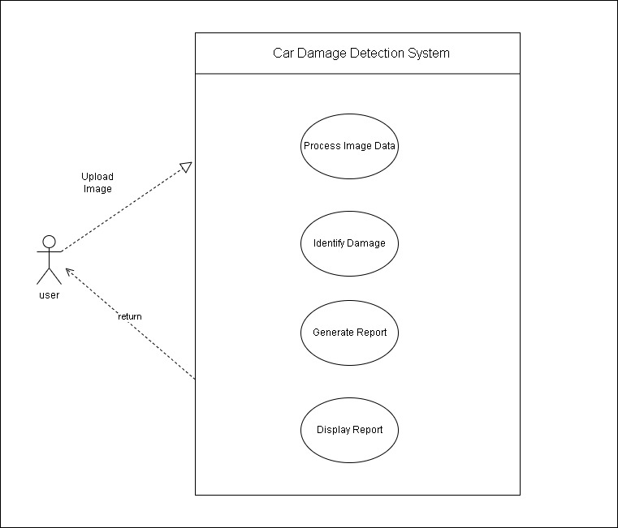
Figure 3: Use Case Diagram

Slide 11
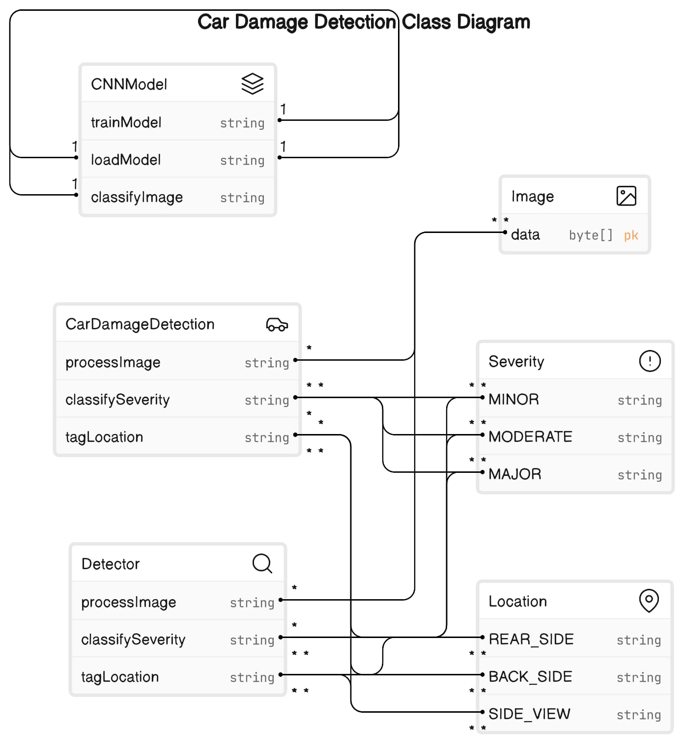
Figure 4: Class Diagram

Slide 12
Technologies Used
Python3
Tensorflow
Keras
OpenCv
HTML
CSS
JS
NBN Sinhgad Technical Institute
2023-2024 Sem VII

Slide 13
Dataset Details:
1) Damaged or not:- Trained using 198 images of damaged cars and 262 images of whole (non-damaged) cars along with the labels Damaged and Whole.
2) Location of Damage:- Total of 979 images divided under 3 labels: Front (419 images), Rear (272 images), Side (288 images).
3) Severity of Damage:- Total of 979 images divided under 3 labels: Minor (315 images), Moderate (278 images), Severe (386 images).

Slide 14
Literature Survey
Sr No. | Title | Authors | Methodology
1 | Automatic Vehicle Damage Detection Classification framework using Fast and Mask Deep learning | Dasari Anantha Reddy, Saroj Shambharkar, Kandi Jyothsna, V Manoj Kumar, Chandrashekhar N Bhoyar, Rachna K. Somkunwar | The proposed framework is capable of predicting the type of vehicle damage i.e. either its minor damage or major damage. The proposed system is based on the machine learning algorithm as it evolving technology in artificially intelligent systems.
2 | Car Damage Identification and Categorization Using Various Transfer Learning Models | Sruthy C M, Sandra Kunjumon, Nandakumar R | Assessing Car Damage with Convolution Neural Networks and also utilizes the keywords ”bumper dent”, ”door dent”, ”glass shatter” etc
Table: Literature Survey
NBN Sinhgad Technical Institute
2023-2024 Sem VII
Group 30

Slide 15
Literature Survey
Sr No. | Title | Authors | Methodology
3 | Car Damage Detection and Assessment Using CNN | Atharva Shirode, Tejas Rathod, Parth Wanjari, Aparna Halbe. | The implementation of this project is done two parts, first one consists of VGG models [10] wherein 3 models are trained using transfer learning. In the second part of implementation, Mask R-CNN [11] has been used for localizing the damage of the car
4 | Automated Detection of Multi-class Vehicle Exterior Damages using Deep Learning. | Maleika Heenaye-Mamode Khan, Mohammad Zafir Hussein Sk Heerah, Zuhairah Basgeeth | Proposed system allows the user to upload a vehicle image through the developed mobile application. We have adapted a pre-trained deep learning model to recognize and classify multiple types of vehicle damages.
Table: Literature Survey
NBN Sinhgad Technical Institute
2023-2024 Sem VII
Group 30

Slide 16
Applications
Insurance Claim Processing.
Accident Documentation for Law enforcement.
Smart Parking System.
Vehicle Maintenance.
Used Car Markets.
Car Rentals.
Car Repair Services.
NBN Sinhgad Technical Institute
2023-2024 Sem VII
Group 30

Slide 17
Advantages
Saves Time
Cost Effective.
Accurate Assessment.
Reduces Fraud.
Real Time Monitoring.
Remote Inspection.
Data Driven Insights.
NBN Sinhgad Technical Institute
2023-2024 Sem VII
Group 30

Slide 18
Conclusion
In conclusion, car damage detection using computer vision presents a transformative approach to assessing vehicle condition across a spectrum of industries. With its remarkable accuracy, consistency, and speed, computer vision technology offers a range of benefits. By providing objective assessments, real-time monitoring, and historical data collection, computer vision contributes to increased efficiency, reduced costs, and improved overall vehicle management. As technology continues to evolve, the integration of computer vision in car damage detection stands as a pivotal advancement with far-reaching implications for the automotive sector and beyond.
NBN Sinhgad Technical Institute
2023-2024 Sem VII
Group 30

Slide 19
References
[1] M. Chen, F. Bai and Z. Gerile, "Special Object Detection Based On Mask Rcnn," 2021 17th International Conference on Computational Intelligence and Security (CIS), 2021, pp. 128-132, doi: 10.1109/CIS54983.2021.00035.
[2] M. Ye et al., "A Lightweight Model of VGG-16 for Remote Sensing Image Classification," in IEEE Journal of Selected Topics in Applied Earth Observations and Remote Sensing, vol. 14, pp. 6916-6922, 2021, doi: 10.1109/JSTARS.2021.3090085.
[3] H. Bandi, S. Joshi, S. Bhagat and A. Deshpande, "Assessing Car Damage with Convolutional Neural Networks," 2021 International Conference on Communication information and Computing Technology (ICCICT), 2021, pp. 1-5, doi: 10.1109/ICCICT50803.2021.9510069.
[4] P. M. Kyu and K. Woraratpanya, “Car Damage Detection and Classification,” in Proceedings of the 11th International Conference on Advances in Information Technology, Bangkok Thailand, Jul. 2020, pp. 1–6, doi: 10.1145/3406601.3406651.
[5] H. Patel, “hemilpatel971/Damage-car-detection,” GitHub, Aug. 13, 2019. https://github.com/hemilpatel971/Damage-car-detection (accessed Feb. 10, 2021).
NBN Sinhgad Technical Institute
2023-2024 Sem VII
Group 30

Slide 20
Thank You

